Slide 1


CS 6831 Designing Secure Cryptography
Tom Ristenpart

Slide 2
Asymmetric crypto so far
RSA
Work in Z_{N} for large composite N = pq
RSA assumption: given Xe mod N can’t recover X without secret key d
Discrete log problem (DLP)
Work in prime-order subgroup of Z_{p} for prime p. g is a generator of subgroup. q is size of subgroup
Discrete log assumption: given g^{x} mod p can’t recover x
*
*

Slide 3
Comparison
Security level | RSA (log N) | DLP in finite field (log p) | DLP subgroup size (log q)
80 | 1024 | 1024 | 160
112 | 2048 | 2048 | 224
128 | 3072 | 3072 | 256
256 | 15360 | 15360 | 512
Exponentiation time performance scales with O(n³) for bit length n numbers
Numerical estimates from best attack times using best known algorithms runtimes

Slide 4
Finite fields
Finite field is a finite set with basic operations:
Addition, subtraction, multiplication, division
Integers modulo prime p is finite field
Notated F_{p} or GF(p) .
The set is {0,1,…,p-1}
Addition is a + b mod p
Multiplication is ab mod p .
We’ve been using this implicitly, just making it explicit.
Finite fields help us build cryptographically suitable elliptic curves

Slide 5
Elliptic curves
Are discrete log based systems. They use a new kind of group defined relative to a finite field. We will use curves over F_{p}
Independently suggested for cryptographic applications by Victor Miller and Neal Koblitz in 1985
They are now the go-to state-of-art in practice

Slide 6
Comparison
Security level | RSA size (log N) | DLP in finite field (log p) | DLP subgroup size (log q) | ECC group size (log q)
80 | 1024 | 1024 | 160 | 160
112 | 2048 | 2048 | 224 | 224
128 | 3072 | 3072 | 256 | 256
256 | 15360 | 15360 | 512 | 512
ECC has smallest representations and fastest performance of asymptotic primitives we have seen

Slide 7
Elliptic curves
An elliptic curve is set of x,y points in F_{p} defined by an equation
E = {(x, y) | y ² = x³ + ax + b mod p}
a,b are fixed values also from F_{p}
Plus one special point O called the “point at infinity”
Technical condition: 4a³ + 27b² ≠ 0
Otherwise curve is not non-singular (has cusps or self-intersections)

Slide 8
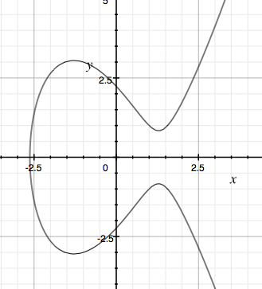
y² = x³ - 5x + 5

Slide 9
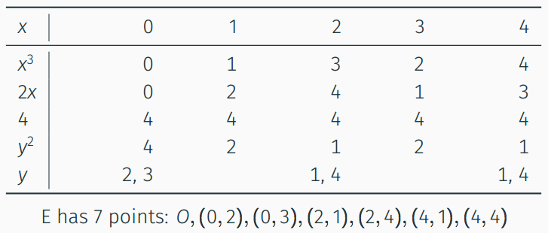

Elliptic curves
Example: y ² = x³ + 2x + 4 mod 5 (i.e., over F₅)

Slide 10
Elliptic curves as groups
Recall that a group is a set G along with an operation * such that for all a,b,c in G:
Closure: a*b in G
Associativity: (a*b)*c = a*(b*c)
Identity: exists 1 in G s.t. 1*a = a*1 = a
Inverses: for all a in G, there exists a⁻¹ in G s.t. a*a⁻¹ = 1
Abelian groups: a*b = b*c

Slide 11
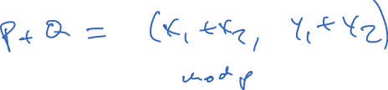
Elliptic curve group operation
The operation * is called “point addition” and we usually denote this P + Q for P,Q in E
What does it mean to “add” two points
P = (x1,y1) and Q = (x2,y2)?

Slide 12

Elliptic curve group operation
Let O be the identity for the group
P+O = O + P = P for any point
Let P⁻¹ be (x,-y) for P = (x,y)
By definition P + P⁻¹ = O
O ⁻¹ = O
P + Q has geometric interpretation

Slide 13

P
Q
R
-R
y² = x³ - 5x + 5

Slide 14
Elliptic curve group operation
Let O be the identity for the group
P+O = O + P = P for any point
Let P⁻¹ be (x,-y) for P = (x,y)
By definition P + P⁻¹ = O
O ⁻¹ = O
P + Q has geometric interpretation
P + Q + R = O

Slide 15




-R’
P’
R’
y² = x³ - 5x + 5

Slide 16
Elliptic curve group operation
Let O be the identity for the group
P+O = O + P = P for any point
Let P⁻¹ be (x,-y) for P = (x,y)
By definition P + P⁻¹ = O
O ⁻¹ = O
P + Q has geometric interpretation
P + Q + R = O
P’ + P’ = -R’
Over finite fields same, but calculate algebraically

Slide 17

Elliptic curve group operation (over F_{p})
Adding P = (x1,y1) , Q = (x2,y2):
Slope is D = (y2-y1) / (x2-x1) mod p
Line through P,Q is
y = D(x-x1) + y1 mod p
Substitute in to curve equation:
(D(x-x1) + y1)² = x³ + ax + b mod p
Only three values of x satisfy equation: x1,x2 and
x3 = D² - x1 - x2 mod p
So: y3 = D(x3-x1) + y1 mod p
Above only works for x1 ≠ x2. Similar calculation though for P + P case

Slide 18
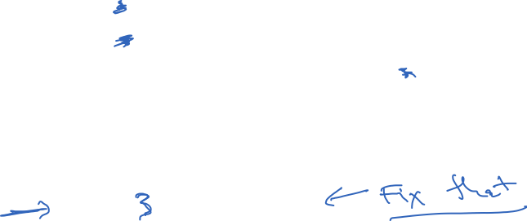
Elliptic curve group operation (over F_{p})
P + Q for P = (x1,y1) Q = (x2,y2)
If P = O then return Q
If Q = O then return P
If x1 = x2 and y1 = -y2 then return O
If x1 = x2 and y1 = y2 then D = (3x1² + a)/(2y1) mod p
Else D = (y2-y1) / (x2-x1) mod p
x3 = D² - x1 - x2 mod p
y3 = D(x2-x1) + y1 mod p
Return (x3,-y3)

Slide 19
Elliptic curve group operation (over F_{p})
Amazingly, point addition is a group operation
Closure: P + Q on curve for all P, Q
Associativity: P + (Q + Z) = (P + Q) + Z
Abelian: P + Q = Q + P
Scalar multiplication nP is just adding P to itself n times
Note that 0P = O and -nP = n(-P)
This is analogous to “exponentiation” in Z_{p}
Can compute with double and add algorithm (same as square and multiply)
Can pick generator P that defines cyclic subgroup of E
{ 0P, 1P, 2P, 3P,…, qP } = all points of interest on curve
(choose so q is big prime)
*

Slide 20
Building elliptic curve groups
How do we find suitable curves?
Pick large prime p
Pick values for a and b to define
y ² = x³ + ax + b mod p
Determine size of group
Schoof in 1985 gave deterministic polytime algorithm
See if group sizes is prime (important for security!)
Pick random point P (not equal to identity) to be generator
All this is a bit slow
Short, better answer: Use predefined ones
NIST curves
Curve25519

Slide 21


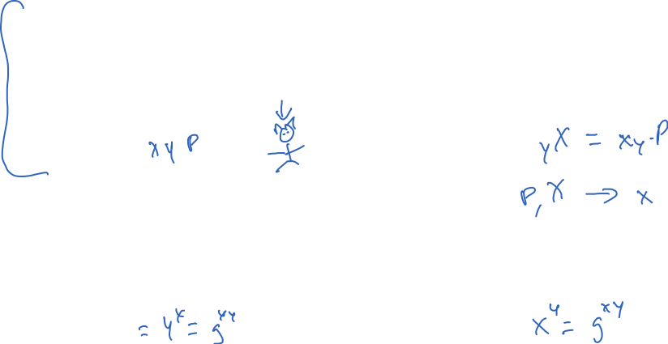
Elliptic curve DH
X
Pick random x from Z_{q}
X = xP
Y
Pick random y from Z_{q}
Y = yP
K = H(xY)
K = H(yX)
X
Pick random x from Z_{|G|}
X = g^{x}
Y
Pick random y from Z_{|G|}
Y = g^{y}
K = H(Y^{x})
K = H(X^{y})

Slide 22
Elliptic curve DLP
Given xP compute x
Same as g^{x} compute x, just different group!
Trivial algorithm requires time O(q), q size of ECC group
Best known algorithm against well-chosen ECC group runs in time q^{1/2}
Algorithm is generic: works against any cyclic group

Slide 23

Baby-Step Giant-Step algorithm
ECDLP: Given xP for random x, compute x
Works in time O(q^{0.5}) and space O(q^{0.5})
Pollard rho method: reduce space to constant
Rewrite x as x = am + b with m = ceil(q^{0.5})
xP + (-am)P = bP
For b = 1, ..., m
Store (b,bP)
For a = 1, ..., m
Check if xP + (-amP) equals one of precomputed bP
Return am + b

Slide 24
Baby-Step Giant-Step algorithm
DLP: Given g^{x} for random x, compute x
Works in time O(q^{0.5}) and space O(q^{0.5})
Pollard rho method: reduce space to constant
Rewrite x as x = az + b with z = ceil(q^{0.5})
g^{x}g^{-az} = g^{b}
For b = 1, ..., z
Store (b,g^{b})
For a = 1, ..., z
Check if g^{x}g^{-az} equals one of precomputed g^{b} values
Return az + b

Slide 25
Elliptic curve DLP
Given xP compute x
Same as g^{x} compute x, just different group!
Corner cases must be avoided, where faster algorithms known:
For anomalous curves where #E(F_{p}) = p DLP solvable in poly time
Some supersingular curves with low embedding degree

Slide 26
Comparison
Security level | RSA size (log N) | DLP in finite field (log p) | DLP subgroup size (log q) | ECC group size (log q)
80 | 1024 | 1024 | 160 | 160
112 | 2048 | 2048 | 224 | 224
128 | 3072 | 3072 | 256 | 256
256 | 15360 | 15360 | 512 | 512
ECC has smallest representations and fastest performance of all asymptotic primitives we will see

Slide 27
What symmetries exist?
y² = x³ - 5x + 5

Slide 28
Point compression
We can compactly represent point (x,y) in E
E = {(x, y) | y ² = x³ + ax + b mod p}
For any x, exactly 0 or 2 solutions to equation
Thus, represent (x,y) in E by x and a bit indicating which y
Almost halves space needed to represent point

Slide 29
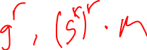
Summary
Elliptic curves are specially constructed groups where DLP is conjectured to be hard
These are faster than RSA or DLP over Z_{p}
Being used increasingly in practice
EC-DSA signature algorithm
TLS EC-DHE (elliptic curve ephemeral DH)
*

Slide 31
The RSA trapdoor permutation
pk = (N,e)
sk = (N,d)
with ed mod φ(N) = 1
f_{N,e}(x) = x^{e} mod N
g_{N,d}(y) = y^{d} mod N
Key generation: pick large primes p and q, then compute d
Prime number theorem says random integer from Z_{N} prime with probability about 1 / log N
Rejection sampling:
Pick random p
If prime, done, otherwise go to 1

Slide 32
The RSA trapdoor permutation
pk = (N,e)
sk = (N,d)
with ed mod φ(N) = 1
f_{N,e}(x) = x^{e} mod N
g_{N,d}(y) = y^{d} mod N
easy given N,e
X
f_{pk}(X)
hard given N,e
easy given N,d

Slide 33
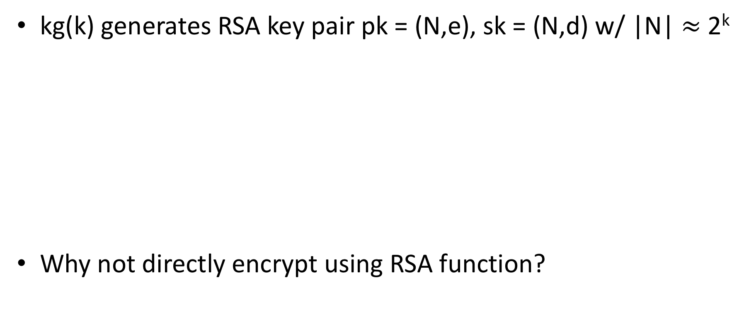
A simple scheme from RSA
kg(k) generates RSA key pair pk = (N,e), sk = (N,d) w/ |N| $≈$ 2^{k}
Why not directly encrypt using RSA function?
Hash function with suitable msg space
One-time secure SE scheme
kg_{s} outputs random n-bit string

Slide 34
Textbook RSA
Why not just use Me mod N directly to encrypt?
Lots of reasons:
It is deterministic!
Ciphertext leaks Jacobi symbol of M (partial information revealed)
Meet-in-the-middle attack for short M that requires 2^{|M|/2} time and space (e.g., |M| = 64)
Malleable (we’ll return to chosen-ciphertext attacks later on)
Small e attacks.
e = 3 and M smallish, M³ < N, solve by taking 3rd root of M³
https://crypto.stanford.edu/~dabo/papers/RSA-survey.pdf

Slide 35
Reminder: deterministic enc not IND-CPA
Say enc is deterministic. How do we win game?

Slide 36
PKCS #1 RSA encryption
kg outputs (N,e),(N,d) where |N|₈ = n
Let B = {0,1}⁸ / {00} be set of all bytes except 00
Want to encrypt messages of length |M|₈ = m
(N,e)
Enc((N,e), M)
pad = n - m - 3 random non-zero bytes
X = 00 || 02 || pad || 00 || M
Return Xe mod N
Enc
M
C
(N,d)
Dec((N,d), C )
X = C^{d} mod N ; aa||bb||w = X
If (aa ≠ 00) or (bb ≠ 02) or (00 w)
Return error
pad || 00 || M = w
Return M
Dec
M or
error
C

Slide 37

TLS 1.2 handshake for RSA transport
Bank customer
Bank
ClientHello, MaxVer, Nc, Ciphers/CompMethods
Pick random Nc
ServerHello, Ver, Ns, SessionID, Cipher/CompMethod
Pick random Ns
Check CERT
using CA public
verification key
CERT = (pk of bank, signature over it)
C
Pick random PMS
C <- enc(pk,PMS)
PMS <- dec(sk,C)
ChangeCipherSpec,
{ Finished, PRF(MS, “Client finished” || H(transcript)) }
ChangeCipherSpec,
{ Finished, PRF(MS, “Server finished” || H(transcript’)) }
Bracket notation
means contents
encrypted
MS <- PRF(PS, “master secret” || Nc || Ns )

Slide 38
How hard is inverting RSA?
Learning p,q from N is
the factoring problem
We don’t know if inverse is true, whether inverting RSA implies ability to factor

Slide 39
Factoring composites
Factor(N):
for i = 2 , … , sqrt(N) do
if N mod i = 0 then
p = i
q = N / p
Return (p,q)
Run time is sqrt(N)
O(sqrt(N)) = O(e^{0.5 ln(N)})

Slide 40
Factoring composites
Algorithm | Time to factor N
Naïve | O(e^{0.5 ln(N)})
Quadratic sieve (QS) | O(e^{c} ) c = d (ln N)^{1/2} (ln ln N)^{1/2}
Number Field Sieve (NFS) | O(e^{c} ) c = 1.92 (ln N)^{1/3} (ln ln N)^{2/3}
Key strength | Modulus size
80 | 1024
112 | 2048
128 | 4096
256 | 15360
https://www.keylength.com/en/4/

Slide 41
Factoring records
Challenge | Year | Algorithm | Time
RSA-400 | 1993 | QS | 830 MIPS years
RSA-478 | 1994 | QS | 5000 MIPS years
RSA-515 | 1999 | NFS | 8000 MIPS years
RSA-768 | 2009 | NFS | ~2.5 years
RSA-512 | 2015 | NFS | $75 on EC2 / 4 hours
RSA-x is an RSA challenge modulus of size x bits

Slide 42
Diffie-Hellman math
Let p be a large prime number
Fix the group G = Z_{p} = {1,2,3,…, p-1}
Then G is cyclic. This means one can give a
member g G , called the generator, such that
Example: p = 7. Is 2 or 3 a generator for Z₇ ?
*
G = { g⁰, g¹, g², … , g^{p-1} }
*
x | 0 | 1 | 2 | 3 | 4 | 5 | 6
2^{x} mod 7 | 1 | 2 | 4 | 1 | 2 | 4 | 1
3^{x} mod 7 | 1 | 3 | 2 | 6 | 4 | 5 | 1

Slide 43
The discrete log problem
Fix a cyclic group G with generator g
Pick x at random from Z_{|G|}
Give adversary g, X = g^{x} . Adversary’s goal is to compute x
easy
x
g^{x}
hard

Slide 44
The discrete log problem
Fix a cyclic group G with generator g
Pick x at random from Z_{|G|}
Give adversary g, X = g^{x} . Adversary’s goal is to compute x
Very slow for large groups!
O(|G|)
Baby-step giant-step is better:
O(|G|^{0.5})
Nothing faster is known for some
groups.
A(X):
for i = 2 , … , |G|-1 do
if X = g^{i} then
Return i

Slide 45
Discrete log problems
 | Given | Compute
Discrete log | g , g^{x} | x
Computational Diffie-Hellman | g , g^{x} , g^{y} | g^{xy}
Decisional Diffie-Hellman | g , g^{x} , g^{y} , g^{xy} -or- g , g^{x} , g^{y} , g^{z} | Which was given

Slide 46
Diffie-Hellman Anonymous Key Exchange
X
Pick random x from Z_{|G|}
X = g^{x}
Y
Pick random y from Z_{|G|}
Y = g^{y}
K = H(Y^{x})
K = H(X^{y})
Get the same key. Why?
Y^{x} = g^{yx} = g^{xy} = X^{y}
What type of security does this protocol provide?

Slide 47
El Gamal encryption
kg chooses random x from Z_{|G|}
pk = X = g^{x} sk = x
G is cyclic group with generator g
IND-CPA secure if DDH holds in G. Why?

Slide 48
G₀ same as INDCPA_{AE}
G₁ same as G₀ except use random Z
G₁ no information about b leaked

Slide 50
El Gamal using integers mod prime p
El Gamal is not IND-CPA using for p prime
DDH is easy in this group!
“Quadratic residue”
For a in :
a = g^{x} and x is even
Legendre symbol
never happens
a = g^{x} and x is odd
Easy to compute:
See Euler’s criterion

Slide 51
DDH for integers mod prime is easy
Fact 1.
Fact 2.
# of quadratic residues (QRs) in equals
 | J_{p}(g^{y}) = 1 | J_{p}(g^{y}) = -1
J_{p}(g^{x}) = 1 | J_{p}(g^{xy}) = 1 | J_{p}(g^{xy}) = 1
J_{p}(g^{x}) = -1 | J_{p}(g^{xy}) = 1 | J_{p}(g^{xy}) = -1
Pr[J_{p}(g^{x}) = 1] = 0.5
Pr[J_{p}(g^{y}) = 1] = 0.5
Pr[J_{p}(g^{xy}) = 1] = 0.75
Compute Legendre symbol for Z
DDH1: Pr[J_{p}(g^{xy}) = 1] = 0.75
DDH0: Pr[J_{p}(g^{z}) = 1] = 0.5
DDH advantage 1/4
Notes:
g^xy is a quadratic residue if xy is even. Xy is even when x or y is even

Slide 52
DDH for integers mod prime is easy
Fact 1.
Fact 2.
# of quadratic residues (QRs) in equals
 | J_{p}(g^{y}) = 1 | J_{p}(g^{y}) = -1
J_{p}(g^{x}) = 1 | J_{p}(g^{xy}) = 1 | J_{p}(g^{xy}) = 1
J_{p}(g^{x}) = -1 | J_{p}(g^{xy}) = 1 | J_{p}(g^{xy}) = -1
Pr[J_{p}(g^{x}) = 1] = 0.5
Pr[J_{p}(g^{y}) = 1] = 0.5
Pr[J_{p}(g^{xy}) = 1] = 0.75
Check that Legendre symbols of X, Y and Z match
DDH1: probability 1
DDH0: probability ½ they match
DDH advantage of 1/2
Notes:
g^xy is a quadratic residue if xy is even. Xy is even when x or y is even

Slide 53
What about DL and CDH?
Best attack known against integers mod prime p is solving DL via generalized number field sieve
If prime factorization of p-1 known, can solve discrete log in subgroups. Factorization usually known (need to find generators)
So we need subgroups to be large
Pick p = 2q + 1 for large prime q (so-called “safe primes”)
Can also use QR subgroup which has order q in this case
prime order has advantages, e.g., exponents have inverses
DDH conjectured to be hard

Slide 55
PKCS #1 RSA encryption
Kg outputs (N,e),(N,d) where |N|₈ = n
Let B = {0,1}⁸ / {00} be set of all bytes except 00
Want to encrypt messages of length |M|₈ = m
(N,e)
Enc((N,e), M, R)
pad = first n - m - 3 bytes from R that
are in B
X = 00 || 02 || pad || 00 || M
Return Xe mod N
R
Enc
C
M
(N,d)
Dec((N,d), C )
X = C^{d} mod N ; aa||bb||w = X
If (aa ≠ 00) or (bb ≠ 02) or (00 w)
Return error
pad || 00 || M = w
Return M
Dec
M or
error
C

Slide 56
Hybrid encryption
Kg outputs (pk,sk)
pk
Enc(pk, M, R)
K||R1||R2 = R
C1 = Enc(pk,K,R1)
C2 = Enc(K,M,R2)
Return (C1,C2)
R
Enc
C
M
sk
Dec(sk, (C1,C2) )
K = Dec(sk,C1)
M = Dec(K,C2)
Return M
Dec
M or
error
C

Slide 57
Security of RSA PKCS#1
Passive adversary sees (N,e),C
Attacker would like to invert C
Possible attacks?

Slide 58
Security of RSA PKCS#1
Passive adversary sees (N,e),C
Attacker would like to invert C
Possible attacks?
Pick |N| > 1024 and factoring will fail
Active attacks?

Slide 59
Bleichanbacher attack
C₁
I’ve just learned
some information
about C₁^{d} mod N
Dec((N,d), C )
X = C^{d} mod N ; aa||bb||w = X
If (aa ≠ 00) or (bb ≠ 02) or (00 w)
Return error
pad || 00 || M = w
Return M
padding error?
C₂
padding error?
…
We can take a target C and decrypt it using
a sequence of chosen ciphertexts C₁, … , C_{q}
where q ≈ 1 million
[Bardou et al. 2012] q = 9400 ciphertexts on average

Slide 60
Response to this attack
Ad-hoc fix: Don’t leak whether padding was wrong or not
This is harder than it looks (timing attacks, control-flow side channel attacks, etc.)
Better:
use chosen-ciphertext secure encryption
OAEP is common choice

Slide 61
Summary
RSA is example of trapdoor one-way function
Security conjectured. Relies on factoring being hard
RSA security scales somewhat poorly with size of primes
RSA PKCS#1 v1.5 is insecure due to padding oracle attacks. Don’t use it in new systems.
Use OAEP instead

Slide 62
TLS handshake for Diffie-Hellman Key Exchange
Client
Server
ClientHello, MaxVer, Nc, Ciphers/CompMethods
Pick random Nc
Check CERT
using CA public
verification key
Check σ
ServerHello, Ver, Ns, SessionID, Cipher/CompMethod
Pick random Ns
CERT = (pk_{s} , signature over it)
Pick random x
X = g^{x}
p , g , X , σ = Sign(sk_{s}, p || g || X)
Pick random y
Y = g^{y}
Y
PMS = g^{xy}
ChangeCipherSpec,
{ Finished, PRF(MS, “Client finished” || H(transcript)) }
PMS = g^{xy}
ChangeCipherSpec,
{ Finished, PRF(MS, “Server finished” || H(transcript’)) }
Bracket notation
means contents
encrypted
MS <- PRF(PMS, “master secret” || Nc || Ns )

Slide 63
Diffie-Hellman math
Let p be a large prime number
Fix the group G = Z_{p} = {1,2,3,…, p-1}
Then G is cyclic. This means one can give a
member g G , called the generator, such that
Example: p = 7. Is 2 or 3 a generator for Z₇ ?
*
G = { g⁰, g¹, g², … , g^{p-1} }
*
x | 0 | 1 | 2 | 3 | 4 | 5 | 6
2^{x} mod 7 | 1 | 2 | 4 | 1 | 2 | 4 | 1
3^{x} mod 7 | 1 | 3 | 2 | 6 | 4 | 5 | 1

Slide 64
The discrete log problem
Fix a cyclic group G with generator g
Pick x at random from Z_{|G|}
Give adversary g, X = g^{x} . Adversary’s goal is to compute x
easy
x
g^{x}
hard

Slide 65
The discrete log problem
Fix a cyclic group G with generator g
Pick x at random from Z_{|G|}
Give adversary g, X = g^{x} . Adversary’s goal is to compute x
Very slow for large groups!
O(|G|)
Baby-step giant-step is better:
O(|G|^{0.5})
Nothing faster is known for some
groups.
A(X):
for i = 2 , … , |G|-1 do
if X = g^{i} then
Return i

Slide 66
Diffie-Hellman Key Exchange
X
Pick random x from Z_{|G|}
X = g^{x}
Y
Pick random y from Z_{|G|}
Y = g^{y}
K = H(Y^{x})
K = H(X^{y})
Get the same key. Why?
Y^{x} = g^{yx} = g^{xy} = X^{y}
What type of security does this protocol provide?

Slide 67
Computational Diffie-Hellman Problem
Fix a cyclic group G with generator g
Pick x,y both at random Z_{|G|}
Give adversary g, X = g^{x} , Y = g^{y}.
Adversary must compute g^{xy}
For most groups, best known algorithm finds
discrete log of X or Y.
But we have no proof that this is best approach.

Slide 68
TLS handshake for Diffie-Hellman Key Exchange
Client
Server
ClientHello, MaxVer, Nc, Ciphers/CompMethods
Pick random Nc
Check CERT
using CA public
verification key
Check σ
ServerHello, Ver, Ns, SessionID, Cipher/CompMethod
Pick random Ns
CERT = (pk_{s} , signature over it)
Pick random x
X = g^{x}
p , g , X , σ = Sign(sk_{s}, p || g || X)
Pick random y
Y = g^{y}
Y
PMS = g^{xy}
ChangeCipherSpec,
{ Finished, PRF(MS, “Client finished” || H(transcript)) }
PMS = g^{xy}
ChangeCipherSpec,
{ Finished, PRF(MS, “Server finished” || H(transcript’)) }
Bracket notation
means contents
encrypted
MS <- PRF(PMS, “master secret” || Nc || Ns )

